Slide 2
Shape, Space and Measure (Geometry)
Year 8 High ability
Students currently working at level 7, working towards level 8
Shape, Space and Measure (Geometry)
Unit will last for 6 weeks and KB will be a focus throughout the entire unit

Slide 3
Core Concepts and Skills
Students have learnt Level 6 and some Level 7 topics previously and will be newto the Level 8 topics.
  Knowing how (procedure) and when (conditional) to apply Pythagoras and Trigonometry in real-life worded contexts
  To encourage student K.B. discourse throughout the unit throughcollaborative work
  To encourage students to create authentic questions in order to understandthe world around them better

Slide 4
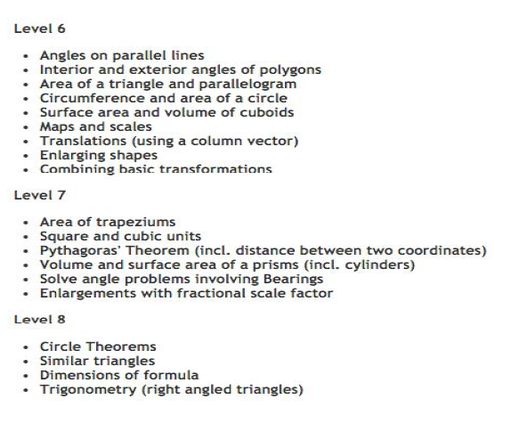

Slide 5
Lesson A : Students watch a short video about the use of
Geometry in everyday life. They discuss in groups the various
occupations/professions that use it. The students put
themselves into the shoes of these professionals and design
Geometry-related question that might ensue.
(For example: A Gardener would ask, how can I work out the
area of this non-rectangular garden)
These questions are used as a basis for curriculum design by
the teacher.

Slide 6
Lesson B (and home-learning) :
Using Edmodo, the teacher creates long, complex and challenging questions emerging from the ideas from Lesson 1. Pupils are encouraged to have discourse offering each other hints and limited guidance to others as opposed to the correct definitive answer.

Slide 7
Lesson C (and home-learning) :
A small selection of students who have demonstrated mastery of conceptualknowledge of the topic are nominated by the teacher to create further authentic questions for their classmates. This will take place on Edmodo.
Other students are expected to contribute to the online discourse with experts offering guidance.

Slide 8
Principles of Knowledge building
● Real ideas and authentic problems
● Rise above
● Community knowledge, collective responsibility
● Pervasive Knowledge building
● Knowledge building discourse

Slide 9
Part II: Implementation
Using skills acquired from learning Area / Perimeter / Circles /Pythagoras students are to discuss approaches to several long-term problems. Ensure that students are only allowed to give hints / clues , maximizing all of their knowledge rather than going to the final answer.

Slide 10
Developing a collaborative culture ….
Create mathematical tasks which may not have definitive answers
Can get students to come up with their own skills or principles in their own words
after being introduced to the idea of this task. Classroom expectations etc ....
Scaffolding comes from each other, teacher can step in if there is a general negativity or a consensus that necessary skills are not learnt.

Slide 11
Constraints
Works much better with a lower ability group who already might lack motivation in mathematics
Not to be tried with students sitting public examination in the short term
May not work well with high ability groups where there are exceptional performers

