Slide 1
Implementing KB Principles in the Secondary English Classroom

Slide 2
Eng. Panel Concerns: Vocabulary
Based on exam results, vocabulary is an area of frustration for teachers at my school
  We spend a lot of time on it
  Students go through near daily dictations
  Exam results show students continue to spell words incorrectly + don’t know the meaning of the words.

Slide 3
Mundane Practices
Students are presented vocabulary within a text
Students are asked to write down the vocabulary word and then write its Chinese equivalent
Students are given word clozes or other fill in the blank tasks
Students memorize the spelling for dictations

Slide 4
My Theory
While focusing on such a narrow area of acquiring vocabulary might not be a good object of a full KB discourse study, there are principles contained within KB theory that can be applied to deliver more consequential outcomes for students learning new vocabulary.

Slide 5
Targeted KB Principles
Real Ideas and Authentic Problems
Epistemic Agency
Community Knowledge, Collective Responsibility

Slide 6
The Content
Unit: Growing Pains (teen problems, issues)
Targeted Vocabulary in the unit (adjectives describing personality):
  Outspoken, pessimistic, stubborn, optimistic, anxious, outgoing, caring, playful

Slide 7
The Plan
Class Organization
  Groups of 4 (8 groups in total)
  Each group assigned a vocabulary word
Tasks
  4 Corners Brainstorm (How does a ____ person behave?; Similar words; Opposite words; a person you know that is ____)
  Group Writing (a script based on their word)
  Script editing (after teacher feedback)
  Group discussion and re-write
  Performance and Edmodo Sharing

Slide 8
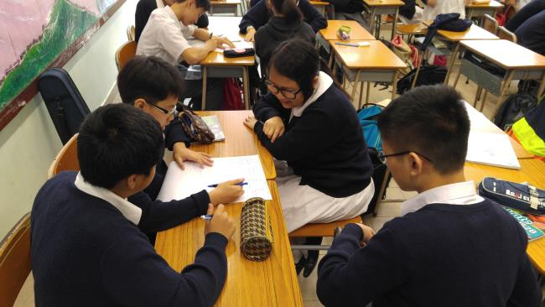
Four Corners

Slide 9
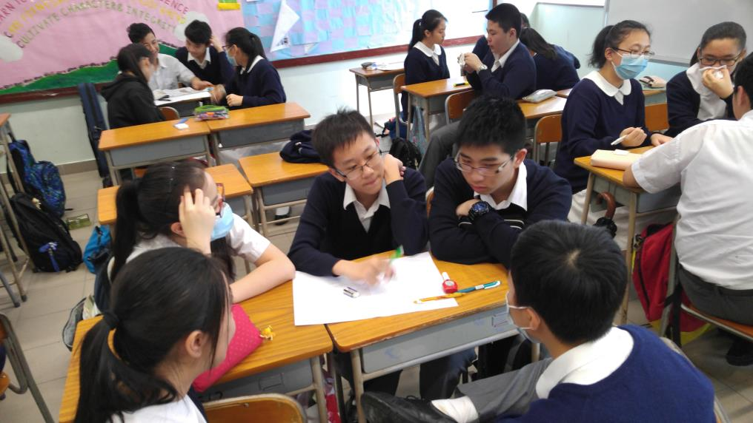
Four Corners

Slide 10
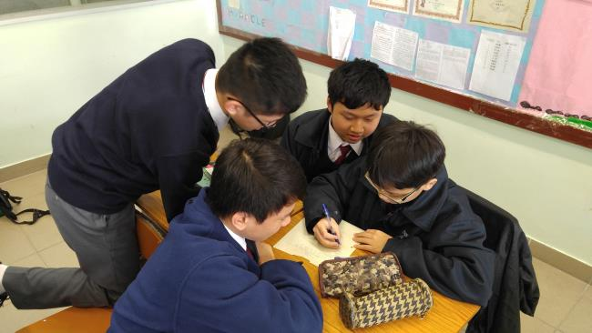
Group Writing

Slide 11
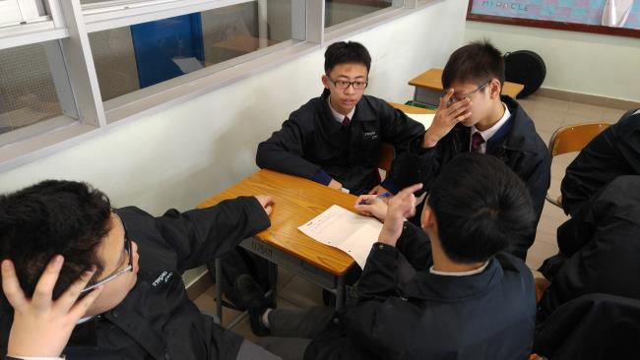
Group Writing

Slide 12
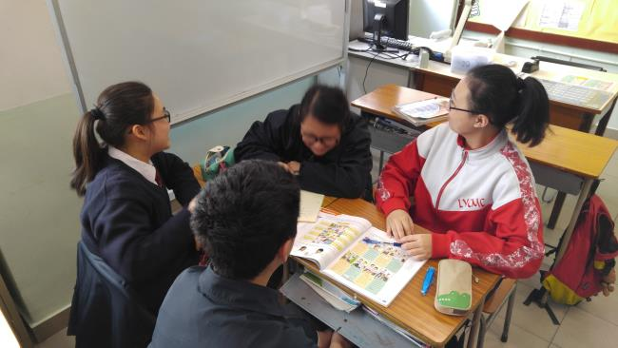
Group Writing

Slide 13
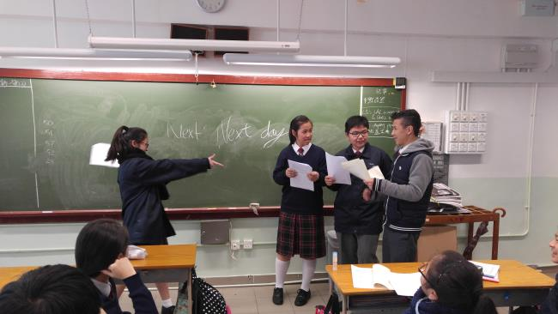
Performance

Slide 14
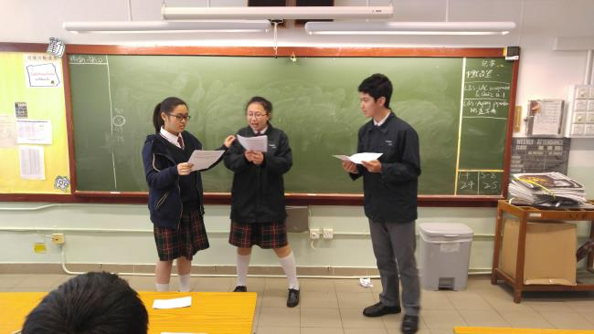
Performance

Slide 15
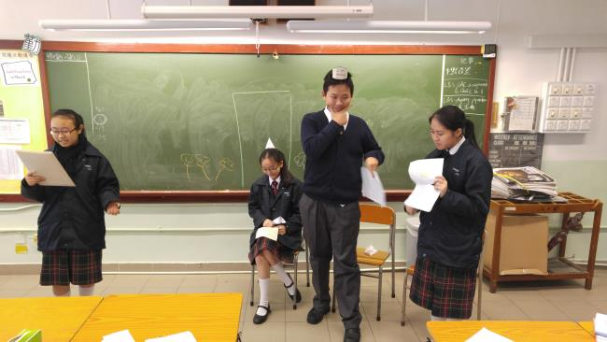
Performance

Slide 16
Reflections
The students, among themselves in their own groups, developed a stronger awareness of the nuances in each of the vocabulary words
Given the opportunity and freedom to ‘mess around’, they did so fruitfully without requiring too much teacher assistance
In the brainstorming, the writing, and the re-writing, students were able to critique each others’ ideas, offer suggestions and agree upon amendments

