Slide 1
Teaching of Biology - Ecosystem
A Knowledge Building Approach

Slide 2
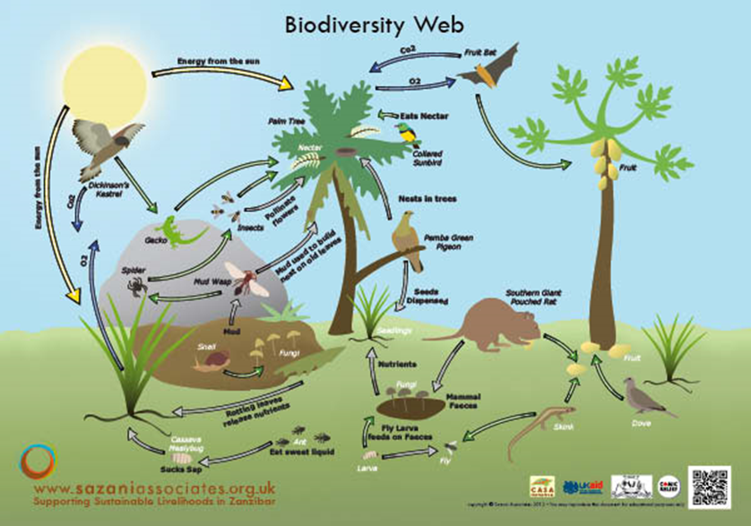
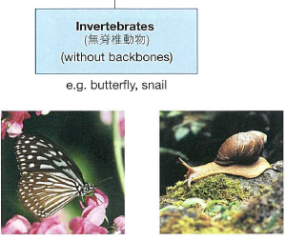
Prior Knowledge
The last chapter - Biodiversity
Classification

Slide 3
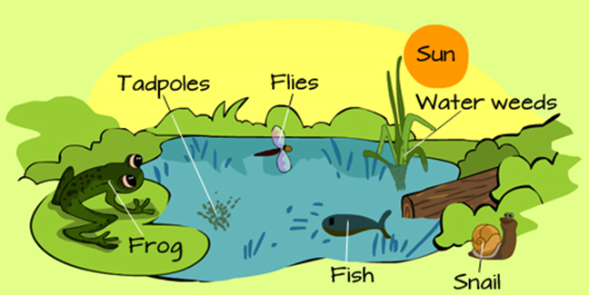
Prior Knowledge
Interrelationships between different organisms
Interrelationships between organisms and the environment

Slide 4
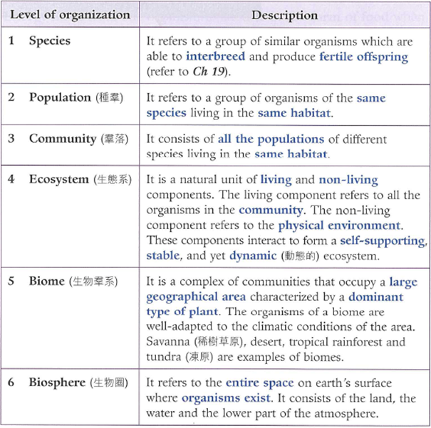
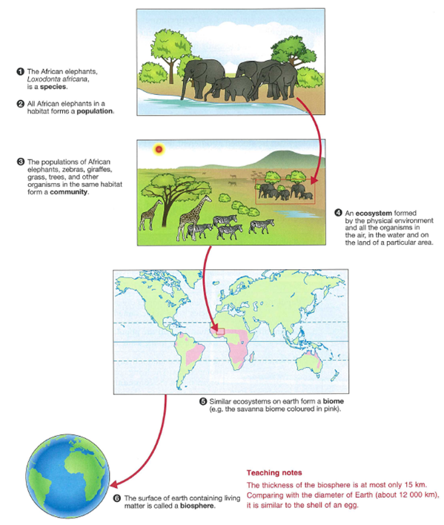
Terms for describing the ecosystem

Slide 5
Sharing on Lessons on Ecology Conducted by Ms. Shea
St. Paul’s Secondary School

Slide 6
Prior Knowledge on Ecology
Terminology:
species, population, community, ecosystem, biome, ecosphere and habitat

Slide 7
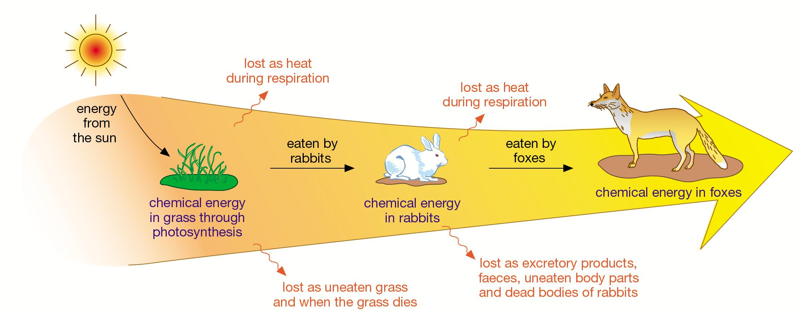
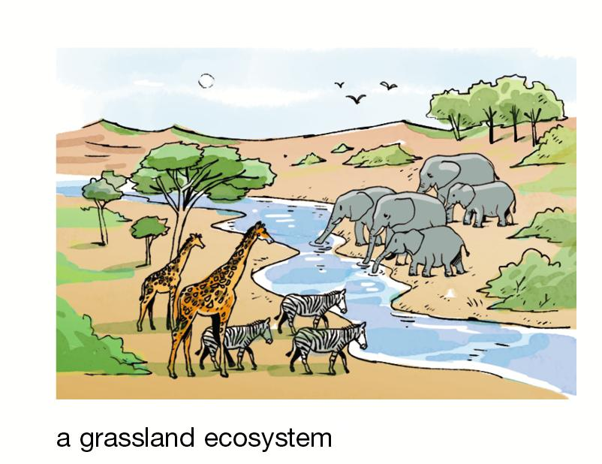
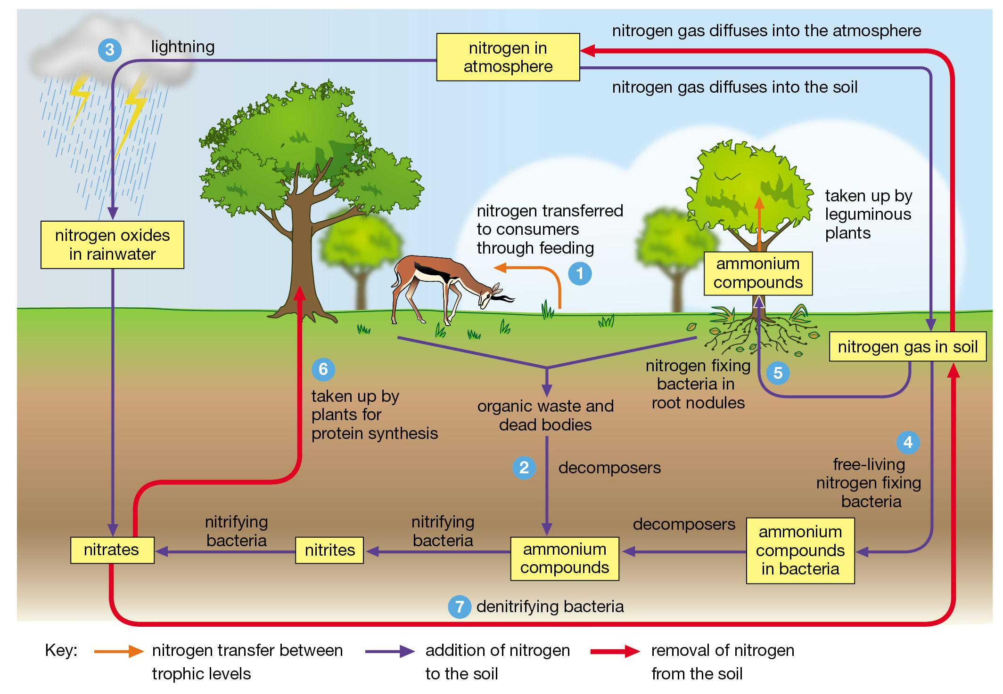
Basic concepts about Ecology
Objectives:
-Students are able to state the basic components of an ecosystem.
-Students are able to describe major concepts related to ecosystems.

Slide 8
Basic concepts about Ecology
How ecosystems work? (Video)
https://www.youtube.com/watch?v=o_RBHfjZsUQ&list=PLIi4e7DUtEHmxoMvXr_6y9rz88KkSul2L
Questions:
Identify the components that make up an ecosystem.
2.Describe one concept related to ecosystems/ ecology.

Slide 9
Basic concepts about Ecology
How ecosystems work? (Video)
https://www.youtube.com/watch?v=o_RBHfjZsUQ&list=PLIi4e7DUtEHmxoMvXr_6y9rz88KkSul2L
Questions:
1. Identify the components that make up an ecosystem.
Ans: organisms (biotic factor), physical environment (abiotic factor, e.g. temperature, light intensity and oxygen)
Describe one concept related to ecosystems/ ecology.
Ans: (1) Interrealationships among organisms
(2) Energy flow
(3) Material cycle

Slide 10
Knowledge Building
And
Knowledge Wall

Slide 11
Level: Form 5
Class: Form 5 Biology 1 and Form 5 Biology 2
Ability: Mixed ability

Slide 12
Biology 1
Topic :
Interrelationships among rocky shore organisms /Adaptations of rocky shore organisms
Rocky Shore (video from Ho Koon Nature Education cum Astronomical Centre) (authoritative source)
https://www.youtube.com/watch?feature=player_embedded&v=40-df6b9DHc
Red – What I understand
Yellow – My theory/ ideas
Green – New information/ Ideas that I need to know

Slide 13
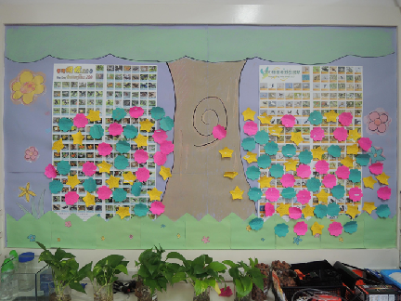
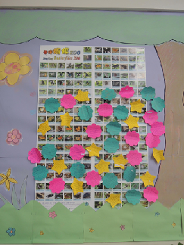

Slide 14
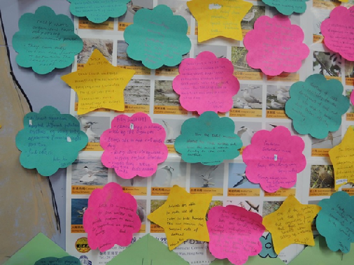
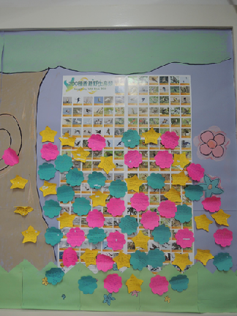
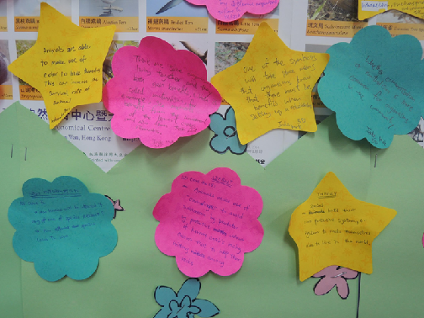

Slide 15
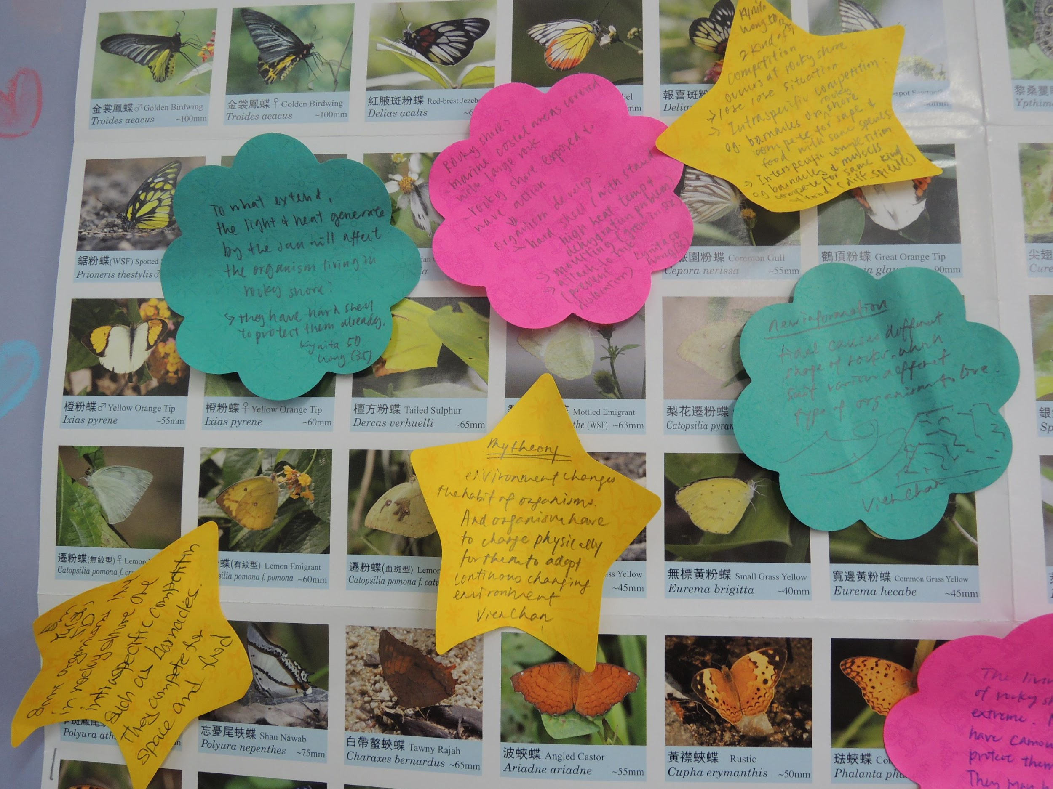

Slide 16
Biology 2
Topic :
Interrelationships among mangrove organisms
/Adaptations of mangrove organisms
Mangrove (video from Ho Koon Nature Education cum Astronomical Centre) (authoritative source)
https://www.youtube.com/watch?feature=player_embedded&v=uYhDWBdC57E
Red – What I understand
Yellow – My theory/ ideas
Green – New information/ Ideas that I need to know

Slide 17
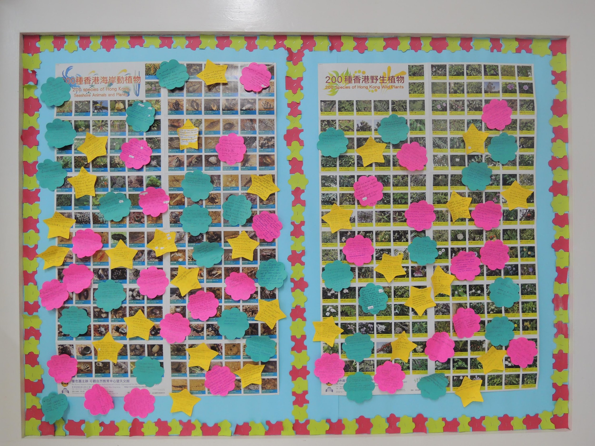

Slide 18
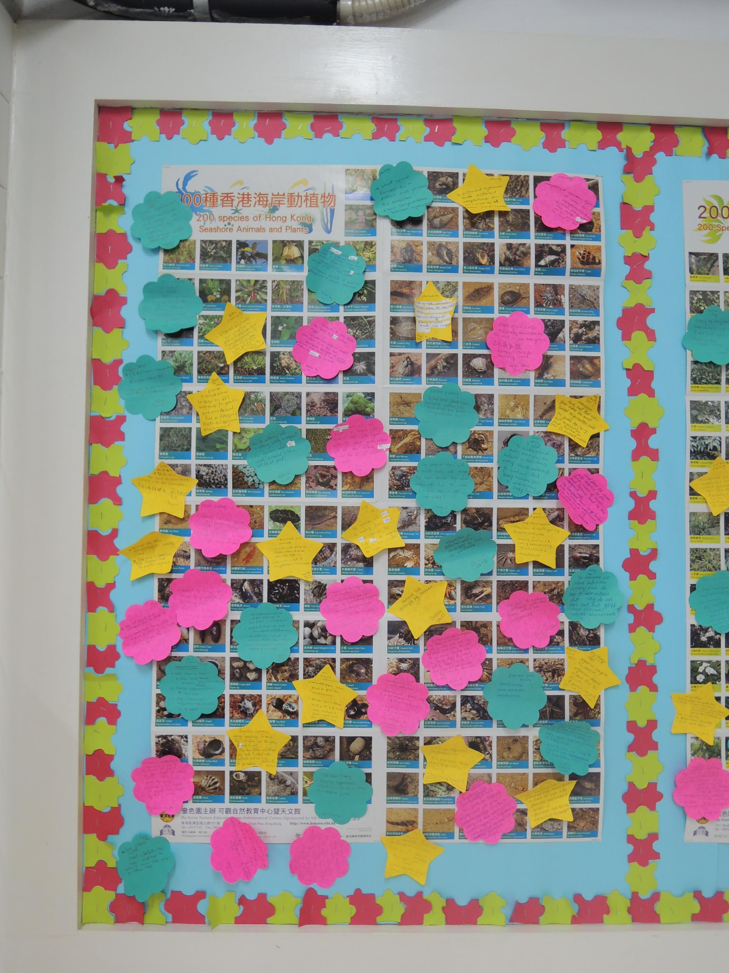

Slide 19
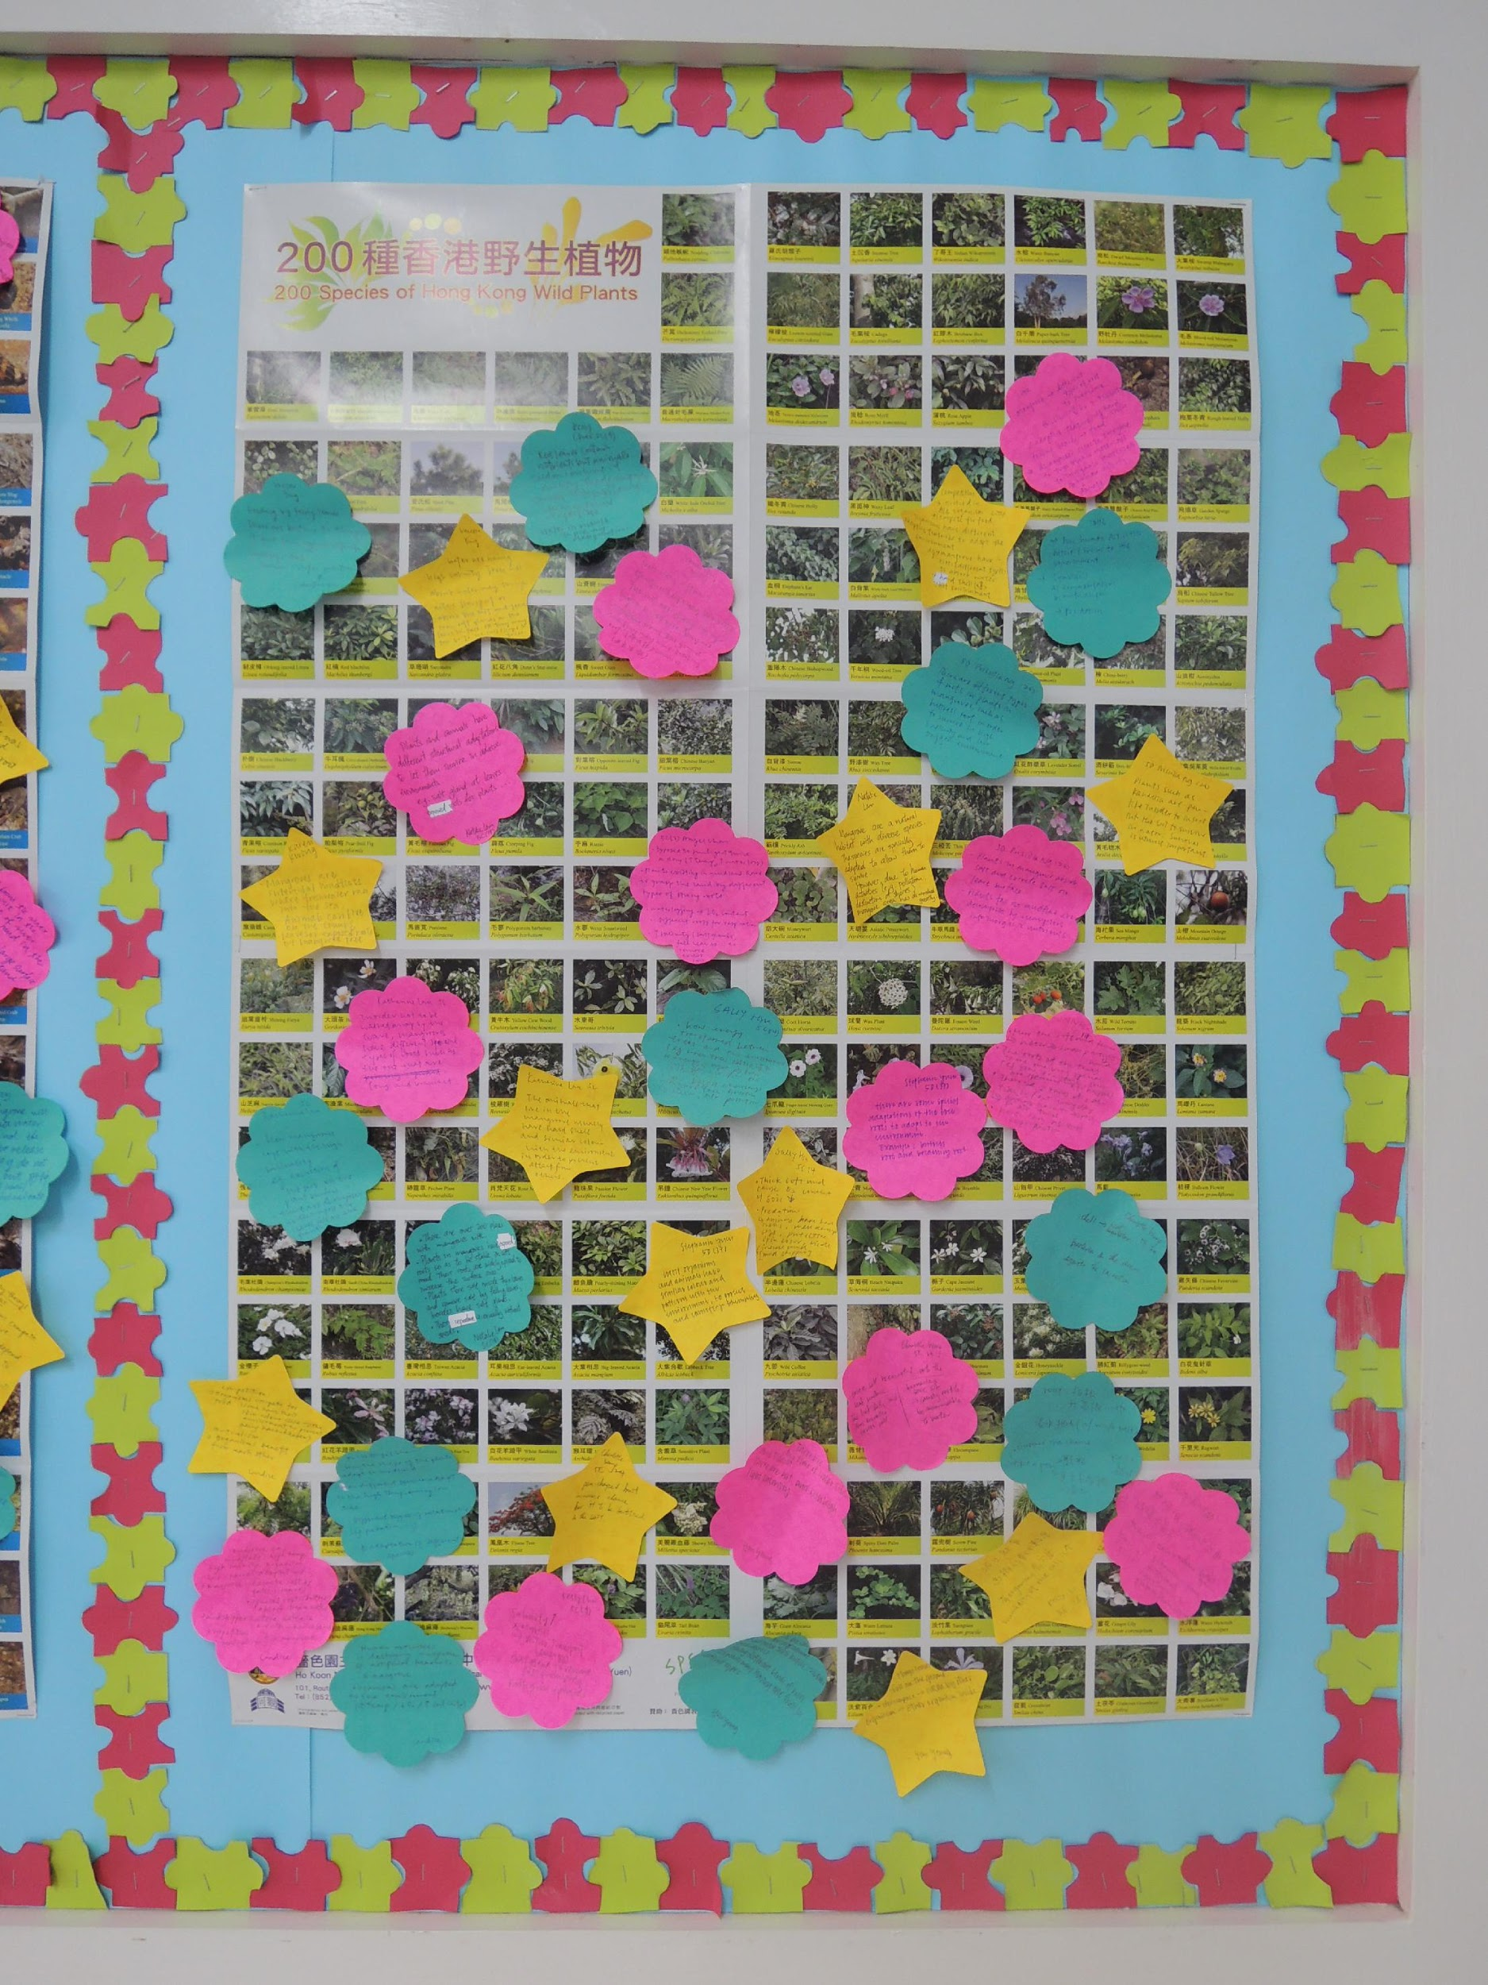

Slide 20
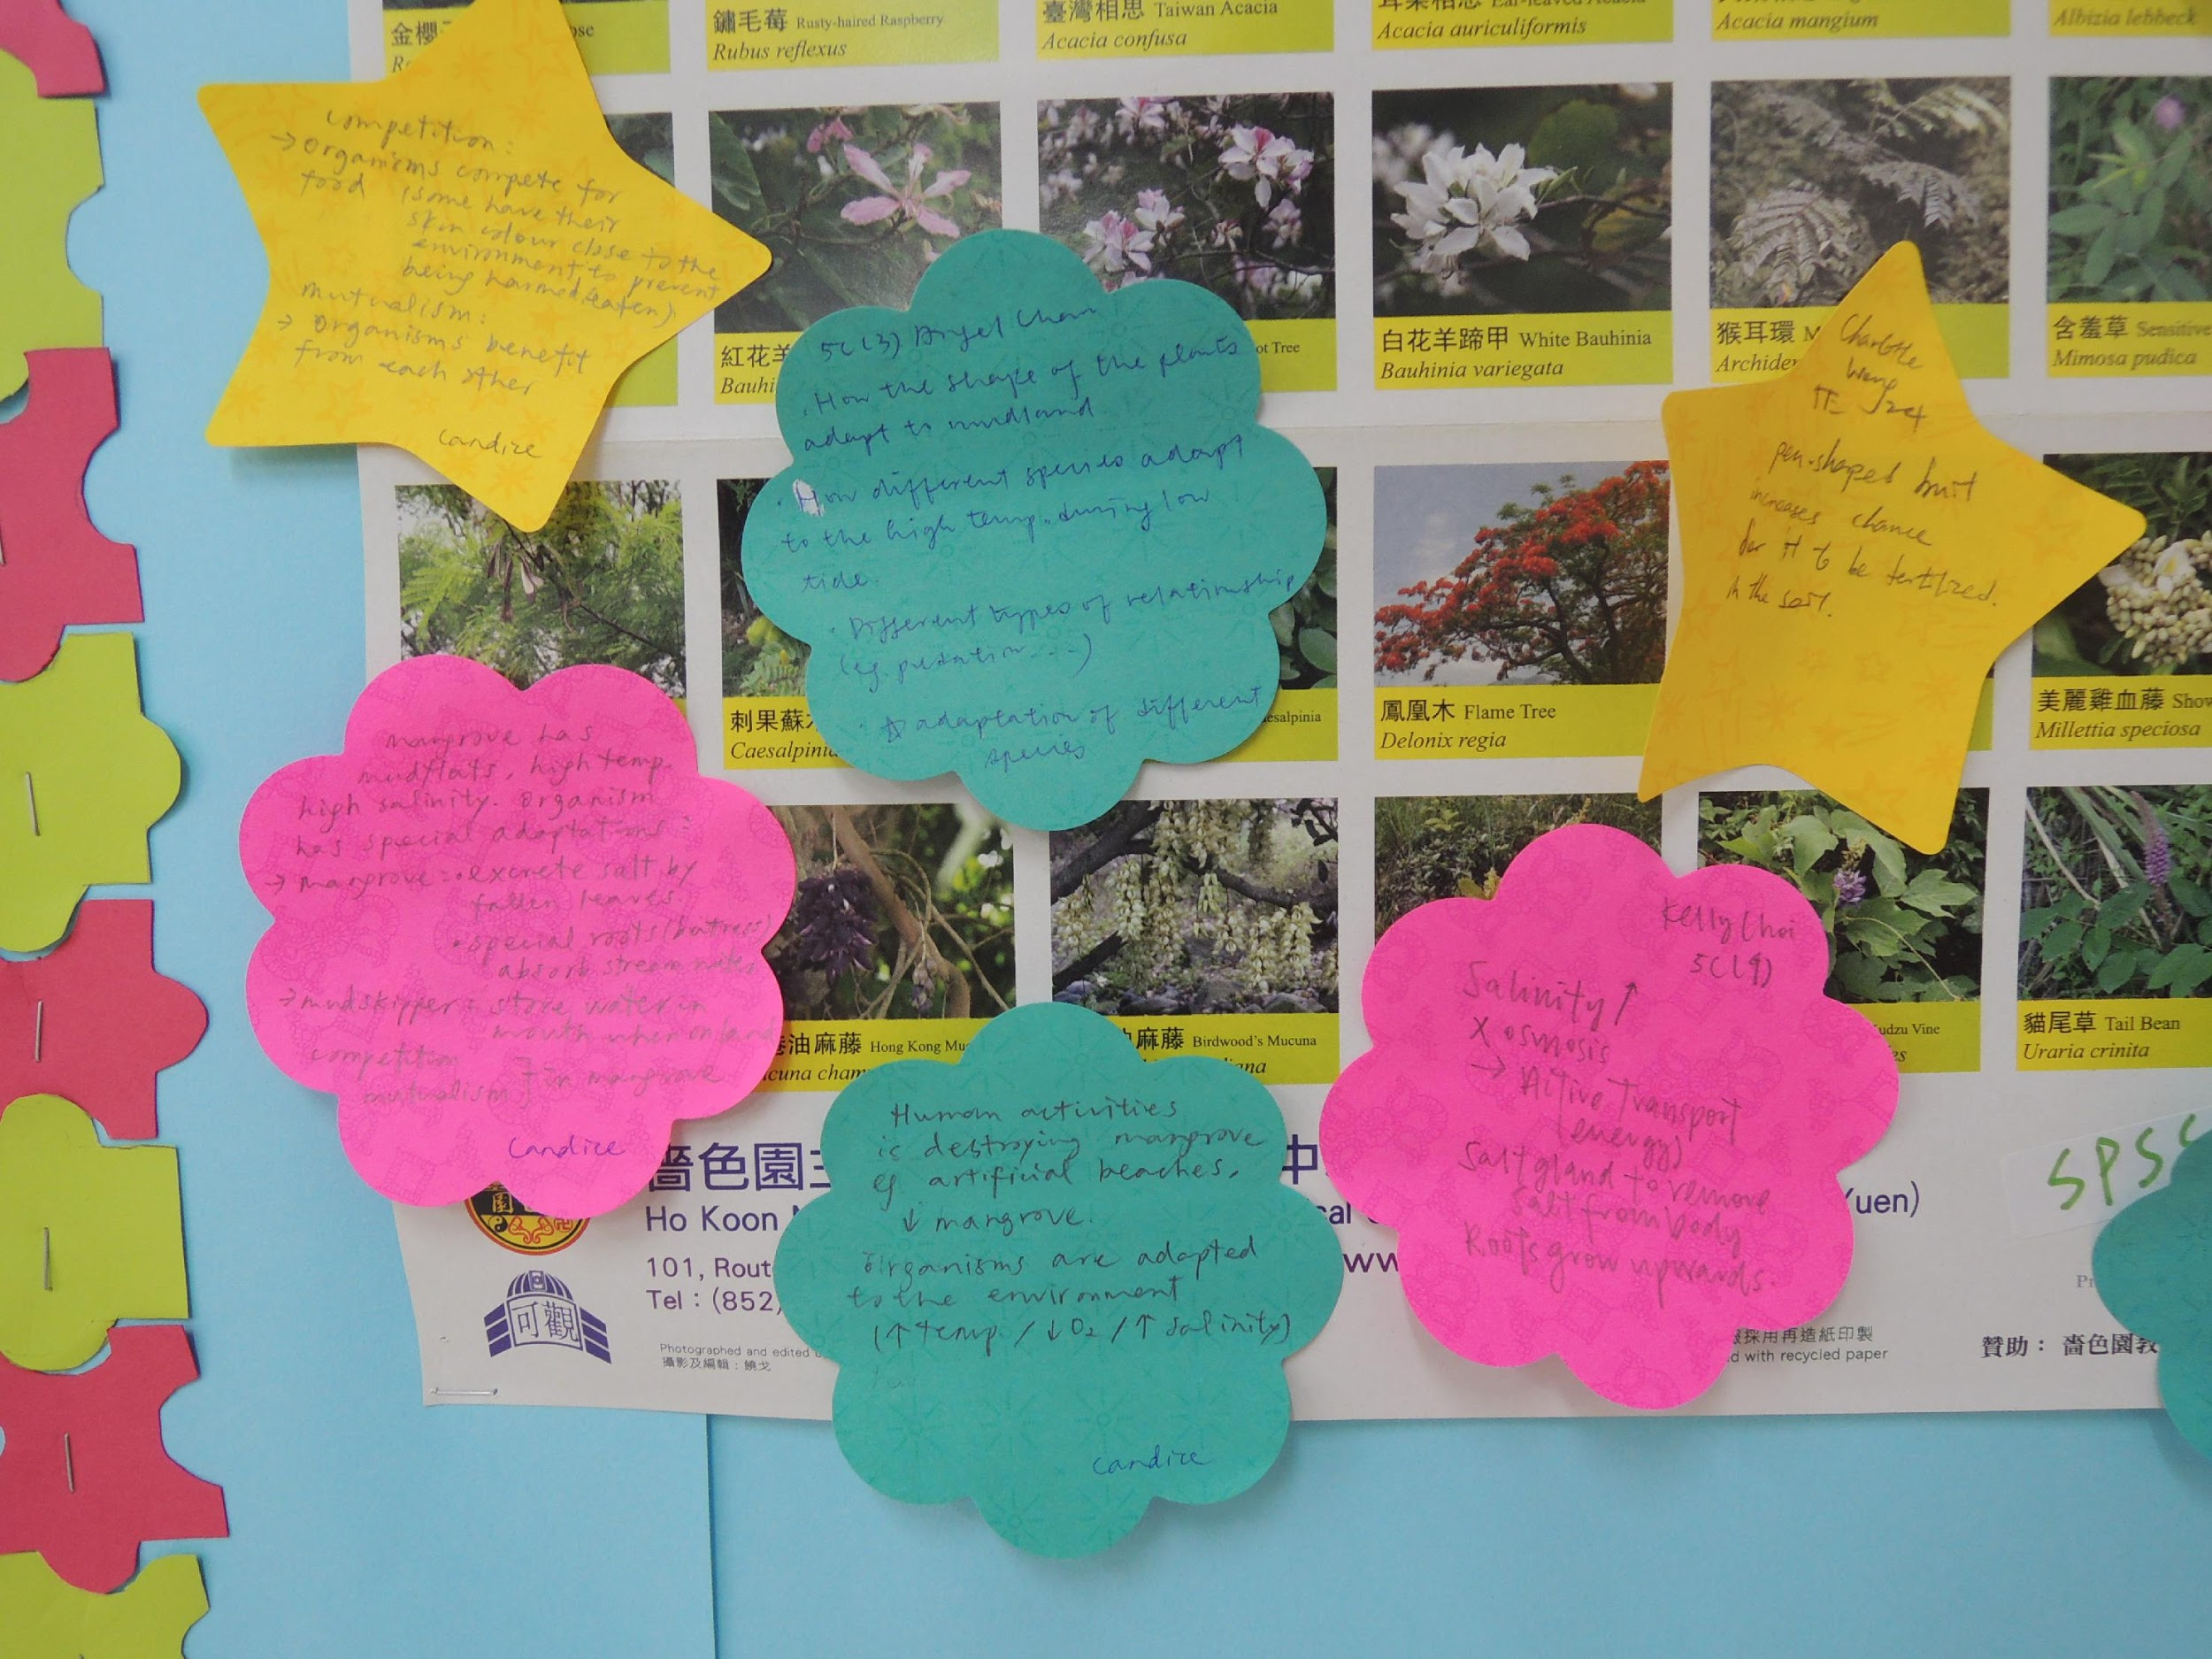

Slide 21
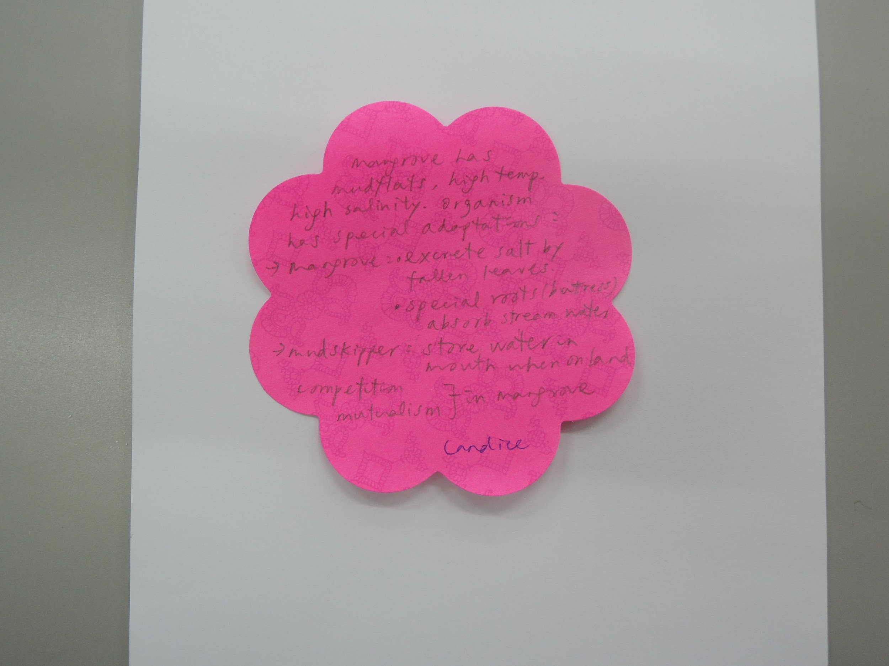
Red – What I understand

Slide 22
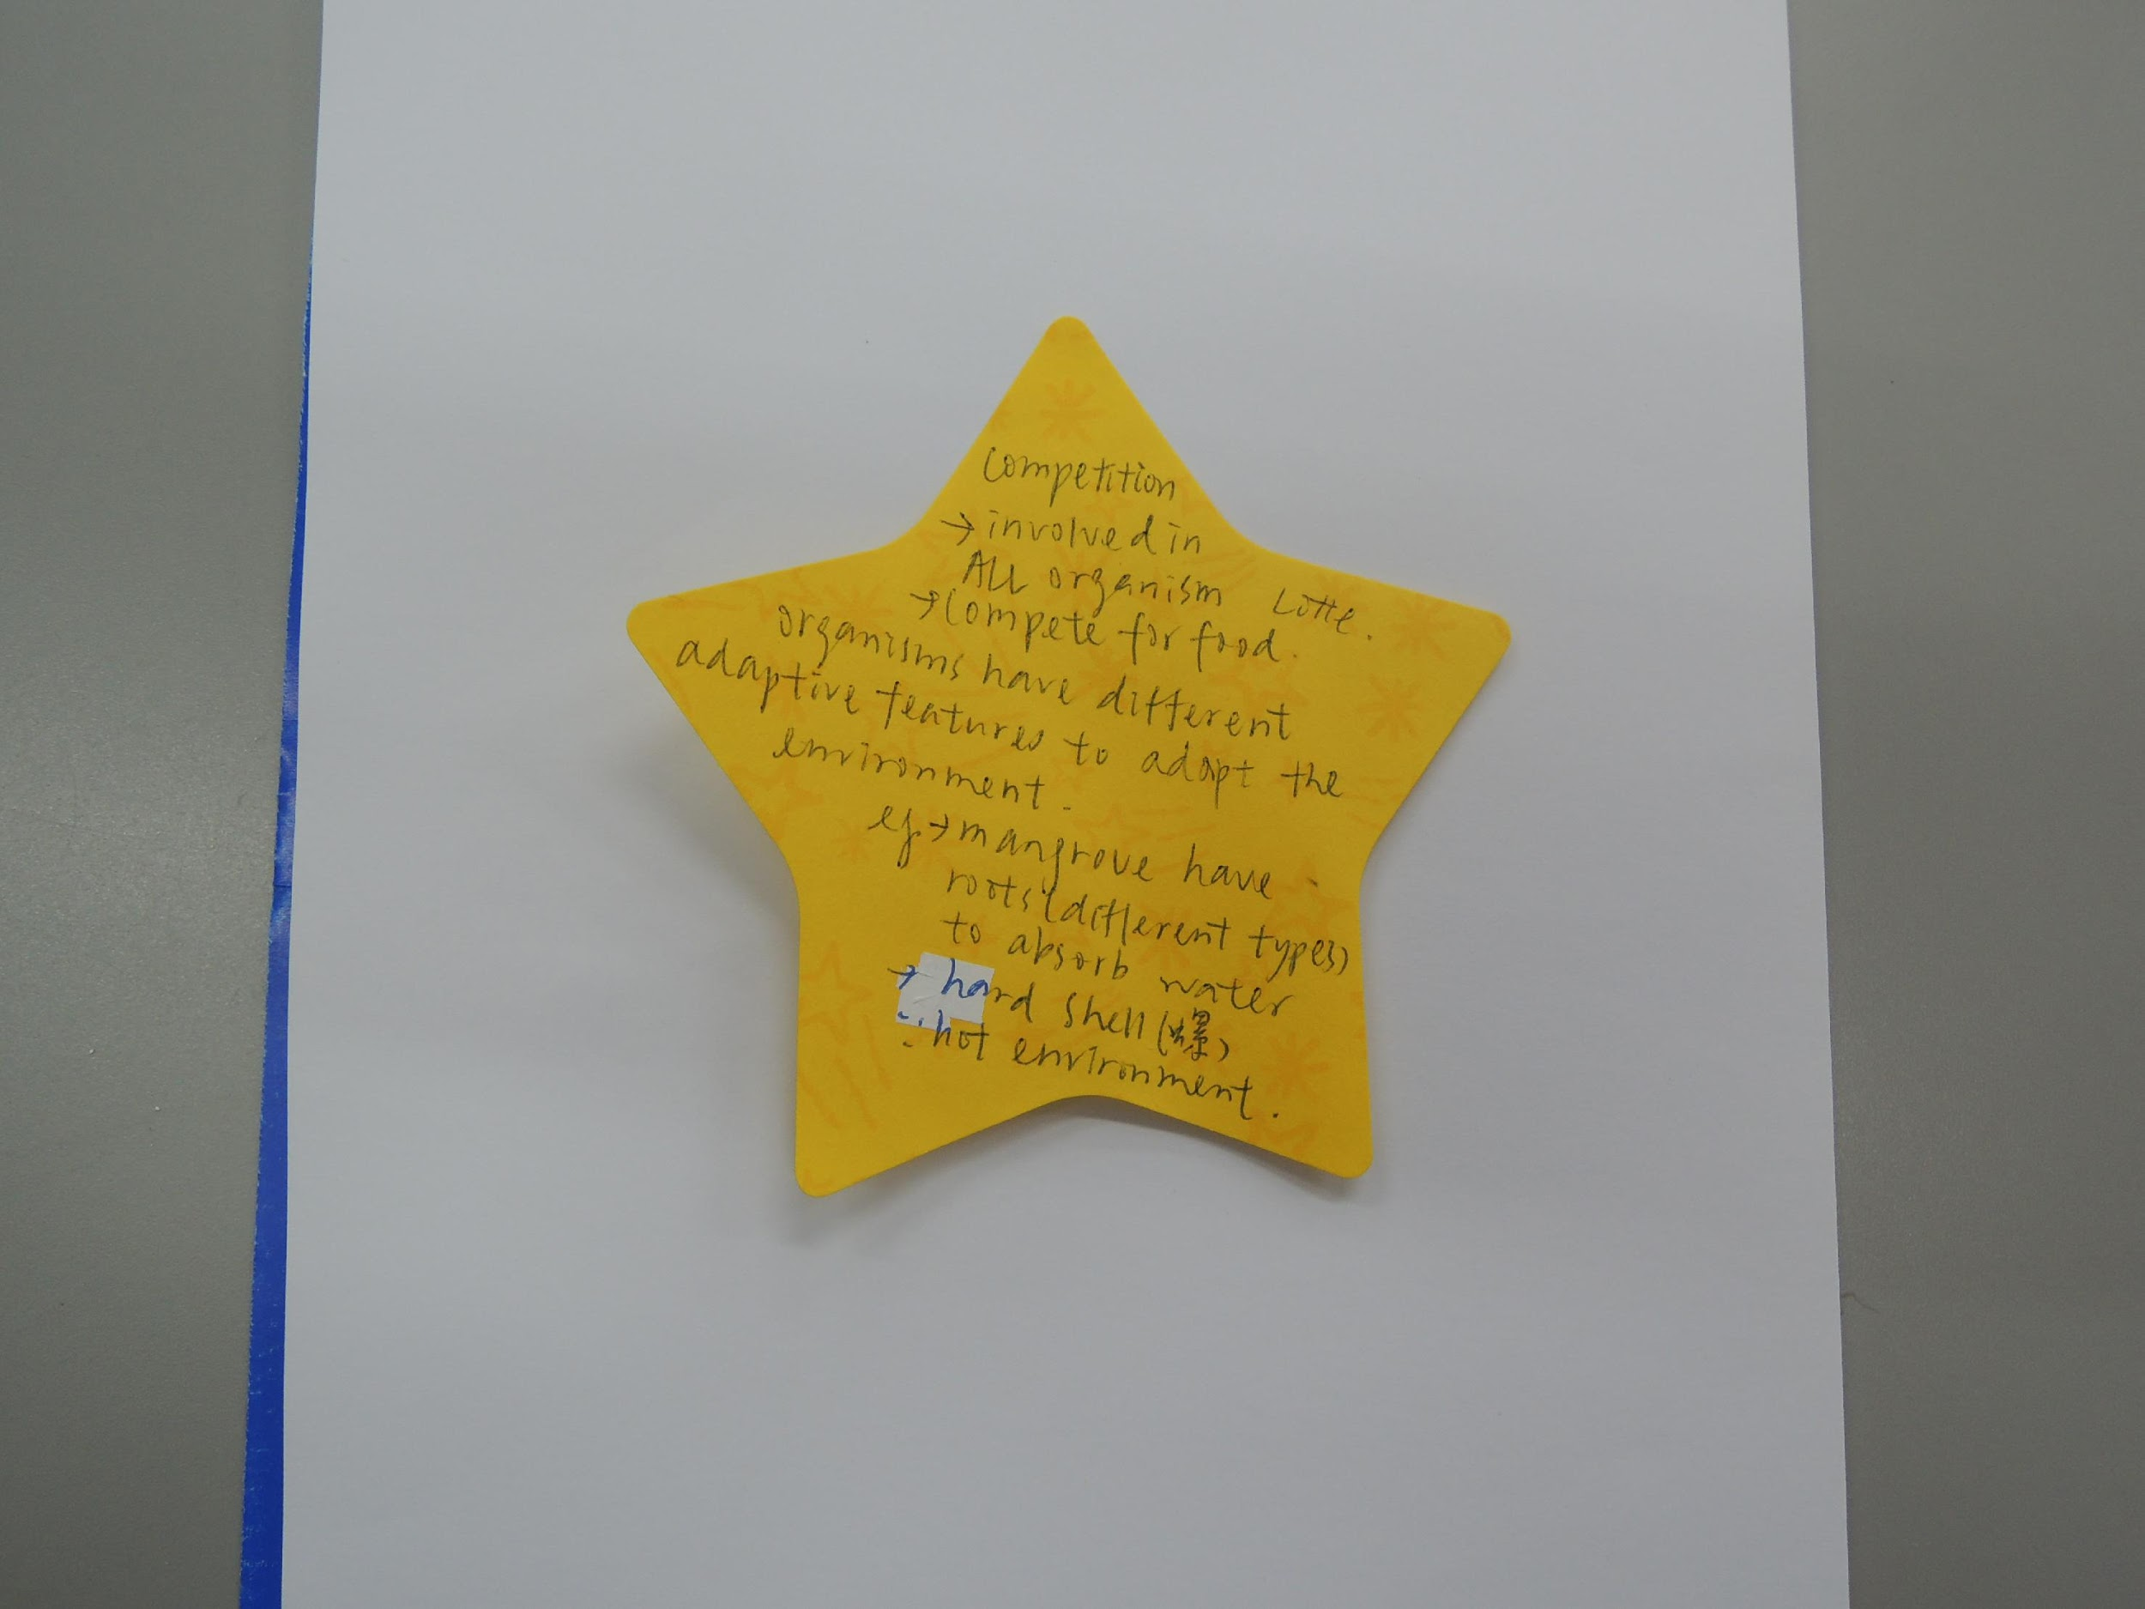
Yellow – My theory/ ideas

Slide 23
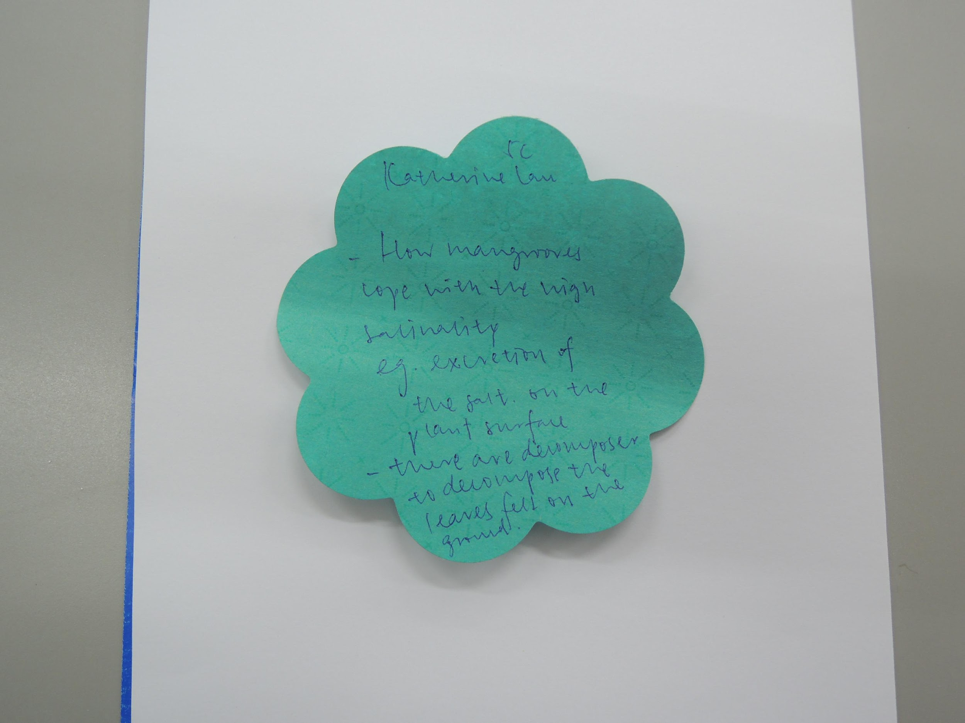
Green – New information/ Ideas that I need to know

Slide 24
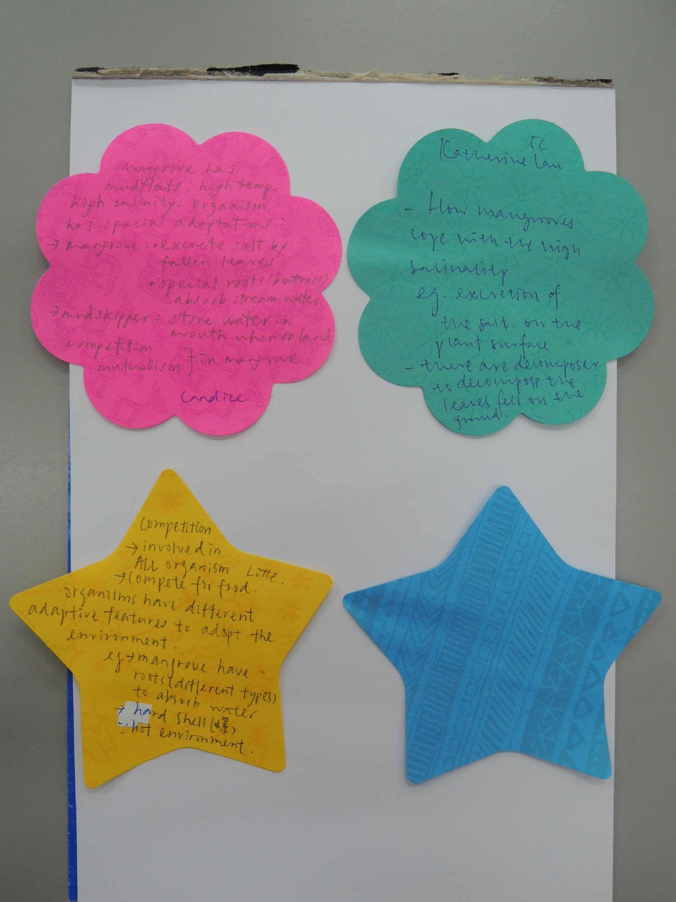
After evaluate some of the notes with the students, each student was asked to do the following:
(1) Read the notes on the wall.
(2) Get back 2 of her notes from the wall.
(3) Get 1 note that was written by another
student from the wall.
(4) Get a blue paper and write an
improvable idea based on any
one of the 3 notes.
(5) Submit next lesson……(to be continued)

Slide 26
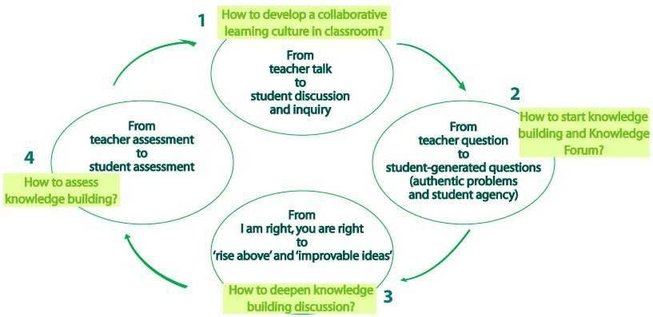
How to conduct knowledge building in classroom?

