Slide 1
Early Primary Literacy
Hong Kong Past & Present
Yuki, Gigi, Myra & Peggy

Slide 2
Our Presentation
Unit Topic: Hong Kong Past and Present
Language Focus:
Past tense
Adjectives
Vocabulary
Format: Project-based Learning
Duration:

Slide 3
Lesson 1
Flipped Classroom
Before class: a video about old Hong Kong (Click Here)
Task: Draw three most impressive things about old Hong Kong mentioned in the video
During class:
Read a text about an old lady’s diary about old Hong Kong
Develop the KWL:

Slide 4
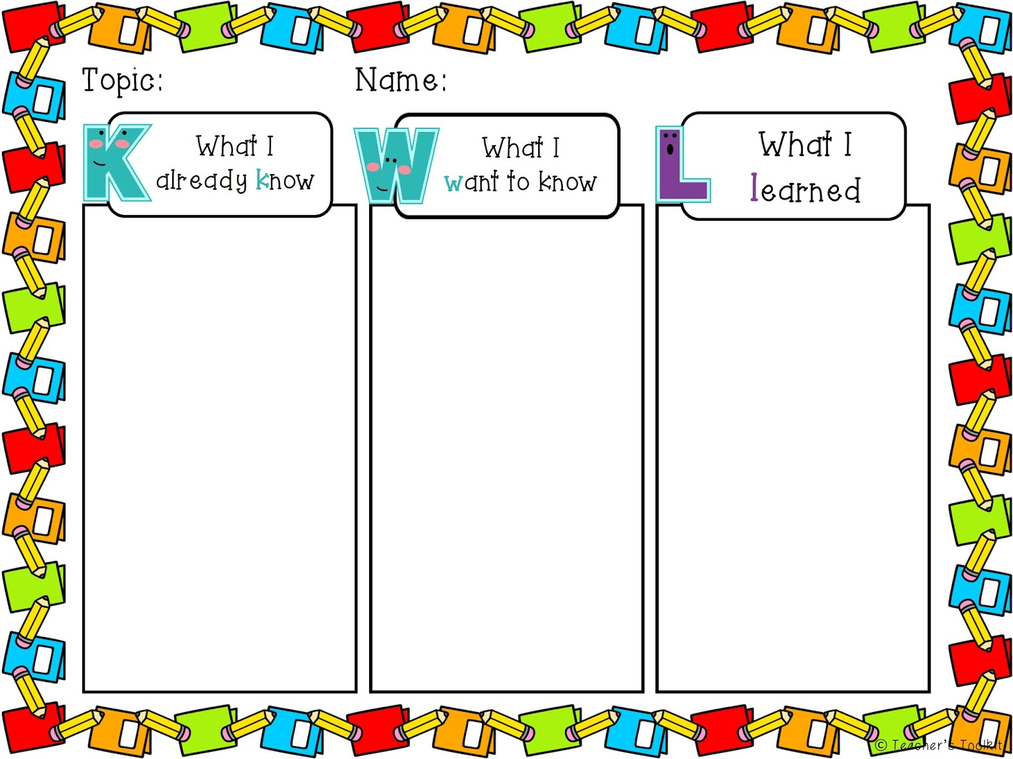

Slide 5
Use MindMeister to develop a mindmap of old Hong Kong

Slide 6
Lesson 2
Focus on present Hong Kong
Jigsaw: texts of different parts of Hong Kong

Slide 7
Field Trip
Jig-saw
Students take photos of Hong Kong

Slide 8
Lesson 3 - Back to class
Home group: students discuss what information they have collected
Put on the mindmap
Expert group: share what they have gathered, ask questions and discuss
Homework:
Get ready of any products they like, take a photo of it and share it online (Collect both how it is like in the past and at present)
Further develop the mindmap at home

Slide 9
Lesson 4
Show products of what they have gathered
Discuss in groups how the products have changed and why
Choose one product in their groups and present it

Slide 10
Lesson 5
Discuss how would you like the future Hong Kong / product / lifestyle to be like
Share it
Draw pictures / 3D products

Slide 11
Principles involved
Real ideas, Authentic Problems
Improvable Ideas
Idea Diversity
Community Knowledge, Collective Responsibility
Epistemic Agency

