Slide 1
Inquiry-based learning in Chemistry
Ivan Lam
26 April, 2013

Slide 2
Examples of authentic problems/ real-world questions for inquiry
What properties do acids / bases have in common ? [Topic: acids & bases]
What makes a cold pack to work ? [Topic: heat of solution]
What causes the rusting of iron to occur ? [Topic: corrosion of metals]
More…

Slide 3
Levels of inquiry (Bell, Smetana & Binns, 2005)
How much information is given to the student ?
Inquiry level |  | Question | Procedure | Solution
1 | Confirmation |  |  | 
2 | Structured |  | 
3 | Guided | 
4 | Open
Duration from one lesson to several weeks

Slide 4
Levels of inquiry in an iron rusting activity
Confirmation inquiry
(Question; Procedure ; Solution )
You are going to use the given procedure to verify that oxygen and water are needed for rusting of iron to happen.
Structured inquiry
(Question; Procedure ; Solution )
You are going to determine the conditions that are needed for the rusting of iron to occur.

Slide 5
Levels of inquiry in an iron rusting activity
Guided inquiry
(Question; Procedure ; Solution )
Design an investigation to answer the question: What conditions are needed for rusting of iron to happen ?
Open inquiry
(Question ; Procedure ; Solution )
Design an investigation to explore the process of rusting of iron.

Slide 6
Inquiry Cycle (White & Frederiksen, 1998)
Question
Predict
Apply
Experiment
Model
The need for curricula designed to scaffold the development of students’ inquiry, modeling and metacognition

Slide 7
Scaffolding strategies for inquiry
Example 1 (structured inquiry)
Predict-Observe-Explain (POE) activity
Predict-Discussion-Explain-Observe-Discussion-Explain (PDEODE) activity
Example 2 (open inquiry)
PowerPoint presentation
Posters / models
Inquiry-based experiment
Knowledge Forum discourse

Slide 8
Example 1 Predict-Observe-Explain (POE) (1)
Class level: F.4
Topic: Rate of reaction
Duration: 1-2 lessons (a benchmark lesson)
Key question:
What factors affect the rate of a reaction ?
Key concepts:
Effects of surface area, temperature and catalyst on reaction rate

Slide 9
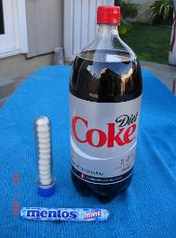
Example 1 Predict-Observe-Explain (POE) (1)
Direct students to predict what will happen when several Mentos candies are dropped into a 2-L bottle of diet coke
(Scaffolds: What would happen if……?)
Ask students to write down the outcome of demonstration, and make a possible explanation
(Scaffolds: I think …..will happen because…)

Slide 10
Example 1 Predict-Observe-Explain (POE) (2)
Video or real demonstration by teacher
Students record what they observe
(Scaffolds: I know that …….
I know this because…)

Slide 11
Example 1 Predict-Observe-Explain (POE) (3)
Compare your observations with your prediction. Are they in agreement or disagreement? Explain.
Reflect on the results and revision of initial (naïve) ideas into scientifically accepted explanation
(Scaffolds: My evidence supports / does not support my prediction because …
I know that ….but I’m still not sure of….)

Slide 12
Example 1 Predict-Observe-Explain (POE) (4)
Discuss student explanations and connect them to the scientifically accepted explanation on surface area of Mentos.

Slide 13
Example 1 (extended discussion) Predict-Discussion-Explain-Observe-Discussion-Explain (PDEODE)
Thought-provoking questions for class discussions:
Why does the Mentos react with the coke to produce this eruption ?
Will one piece of Mentos produce this same effect ? [effect of surface area]
Why should we use diet coke instead of regular coke ? Can we use diet Pepsi or Fanta instead ?
Will the ‘refrigerated’ diet coke produce the similar effect ? [effect of temperature]
Notes:
Benefits : science process skills, articulate their prior knowledge / misconceptions

Slide 14
Example 1 (extended discussion) Predict-Discussion-Explain-Observe-Discussion-Explain (PDEODE)
POE supported with peer discussions/ ideas diversity in the explanation phases
Scaffolding with peer emerging questions and collaborative discourse
(Scaffolds: I agree with you that …., but I disagree with you that…
The evidence supports / does not support your claims that ….
I used to think…., but now we think….)

Slide 15
Example 2 An example of open inquiry
Class level: F.4
Topic: Electrochemistry – Chemical cells
Duration: 2-3 weeks
Key question:
What causes a chemical cell to be able to run a wall clock?
Key concepts: oxidation-reduction reaction, chemical cell, half-cell & electrochemical series

Slide 16
Example 2 Scaffolding with PowerPoint presentation, posters, models and knowledge building discourse
Scenario of inquiry
Your clock has run out of the battery, and you don’t have any new battery for replacement. Design and explore a home-made chemical cell using simple household materials that can be applied to power the clock.
What do you know ?
What do you need to know ?
How can you find out what you need to know ?

Slide 17
Example 2 Stage 1: scaffolding with PowerPoint presentation
Scaffolding inquiry process
Brainstorming ideas to identify research questions
Supporting with evidence-based websites
Integrating scientific understanding with prior commonsense knowledge
Applying new knowledge in PowerPoint presentation
Reflect and assess community knowledge

Slide 18
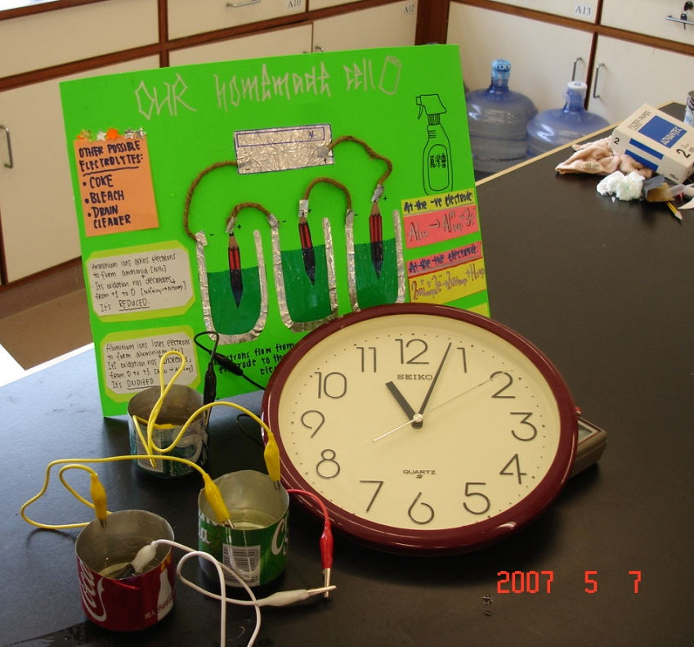
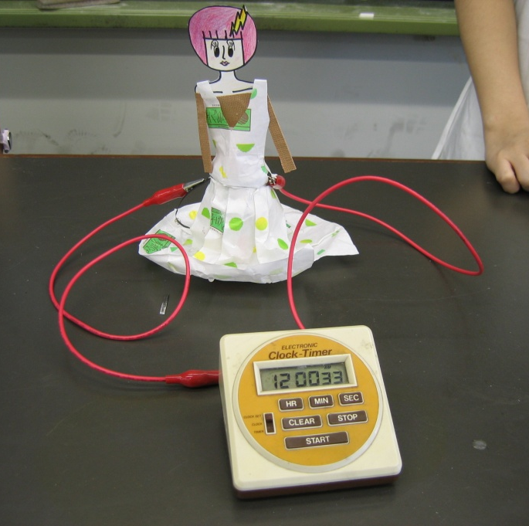
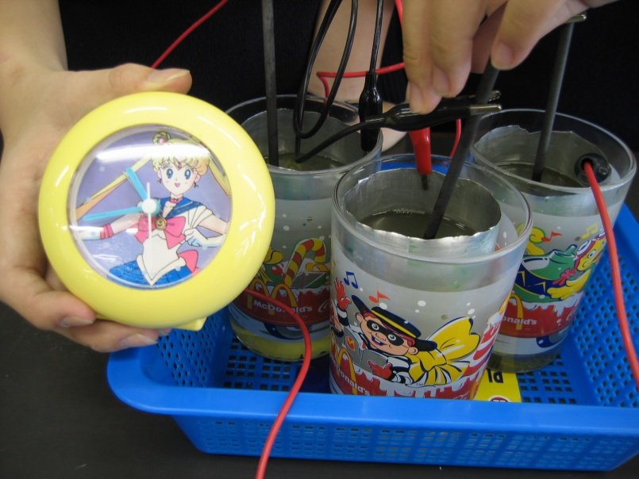
Example 2 Stage 2: Scaffolding with posters and models
Students construct posters and models to explain the design and working principles of own chemical cells.

Slide 19
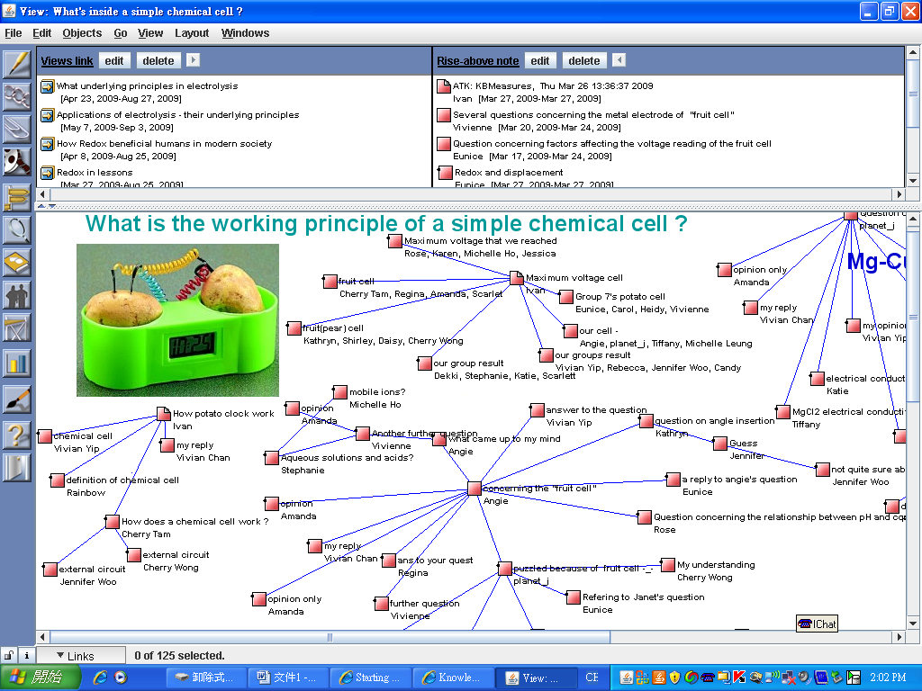
Example 2 Stage 3: Scaffolding with knowledge building discourse
Key question for inquiry
Exemplars notes for modeling
Students’ thread of notes
Notes:
Create ‘Views’ in KF for inquiry aligning with curriculum units to address the misconceptions and daily phenomena
Use videos/animations and student-generated questions arising from problems as conceptual artifacts to initiate inquiry

Slide 20
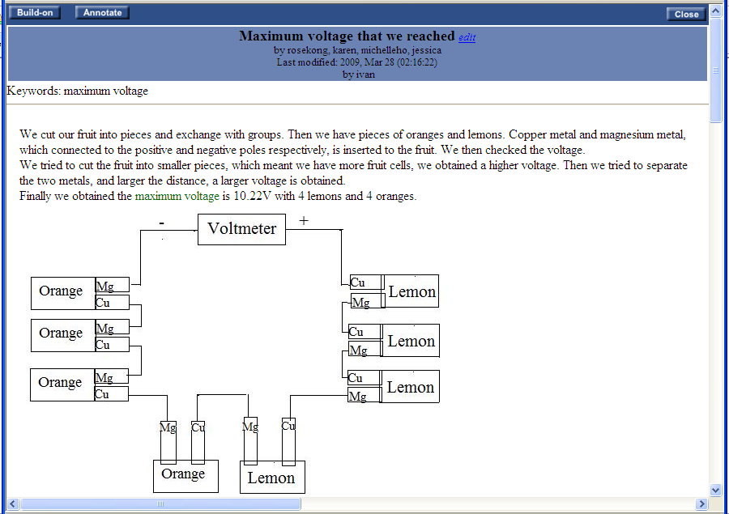
Example 2 Stage 3: Scaffolding with knowledge building discourse
Develop deep understanding through model-based explanatory inquiry on KF
Scaffolds: How reliable are the data ?
How might you change the experiment in the future ?
Notes:
Create ‘Views’ in KF for inquiry aligning with curriculum units to address the misconceptions and daily phenomena
Use videos/animations and student-generated questions arising from problems as conceptual artifacts to initiate inquiry

Slide 21
Student’s reflection in KF learning journal
My belief on learning & knowledge
The most useful part of this activity is it broadens our thinking by relating one topic to another… Classroom activities help build our foundation on new erudition. It also provides us with exercises and practice to strengthen our understanding. Experiments offer us a chance to witness how scientific reactions occurs. …. KF is a platform where…we can express our views, raise questions… Through reviewing the thoughts and inquiries of classmates, we can acknowledge our own misconceptions and… we can help others to correct their misconceptions…..

Slide 22
Scaffolding inquiry can…
Articulate students’ prior knowledge and beliefs, makes ideas public (assess and reflect)
Enhance students’ agency of learning and collaboration
Develop science process skills
Facilitate creativity, metacognition and intrinsic motivation
Promote conceptual understanding and remedy misconceptions
Develop sophisticated epistemic beliefs on knowledge and knowing

Slide 23
Challenges and concerns
Lack of lesson time
Lack of effective instructional materials
Large class size (n = 36)
Low participation of passive students

Slide 24
Suggestions or recommendations
Lack of lesson time
Confirmation, structured and guided inquiry can serve for different learning purposes.
Include one open inquiry embedded within the existing chemistry curriculum in each year, and involve extra-curricular time for open inquiry
Allow students to share raw data from similar experiments, and to use computer simulations for data collection to reduce time
Play videos on demonstrations to model scientific phenomena or principles instead of teacher’s demonstrations in P-O-E inquiry

Slide 25
Suggestions or recommendations
Lack of effective instructional materials
Modify the ‘cookbook’ experiments/activities from own textbook or other references by deleting the procedure, data table or questions for analysis
Formulate the meaningful inquiry problems/ questions using existing videos or real-world research data from Internet, e.g.
Which brand of bleach is the best buy?
What causes the greenhouse effect?

Slide 26
Suggestions or recommendations
Large class size (n = 36)
Divide the class into groups of 4 students for inquiry activities
Select two or three groups for oral / PowerPoint presentation to find out the limitations and common concerns of experimental design
Set up knowledge building boards and engage students in Knowledge Forum or other technology-supported discussion forums for co-constructing community ideas

Slide 27
Suggestions or recommendations
Low participation of passive students
A gradual progression from low-level to high-level inquiry over the year, coupled with appropriate scaffolding, can result in greater student success and satisfaction.
Aligning the inquiry learning with formative and authentic assessment such as PowerPoint presentations, experimental design, procedures, models, posters and lab reports

