Slide 1
Water Challenge & Problem
Primary 4 General Studies
Lesson 1

Slide 2
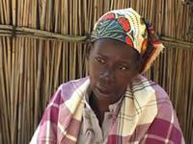
World Vision - Video: Camilla’s Story
Name: Camilla
Home: Mozambique, Africa
Background: Her two children died of diarrhea and cholera.

Slide 3
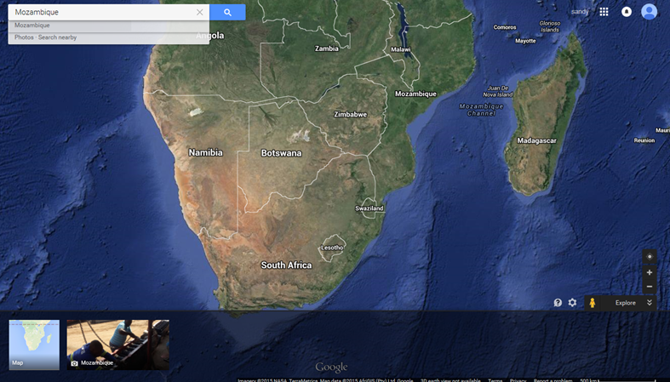
Mozambique - Where is it?

Slide 4
What is the problem? How does the problem arise?

Slide 5
Individual Task - 5 minutes
Please write down your thoughts and ideas on the worksheet after reading the following questions:
What are the problems associated with water? How do they arise?
What questions do you want to ask? What do you not understand?

Slide 6
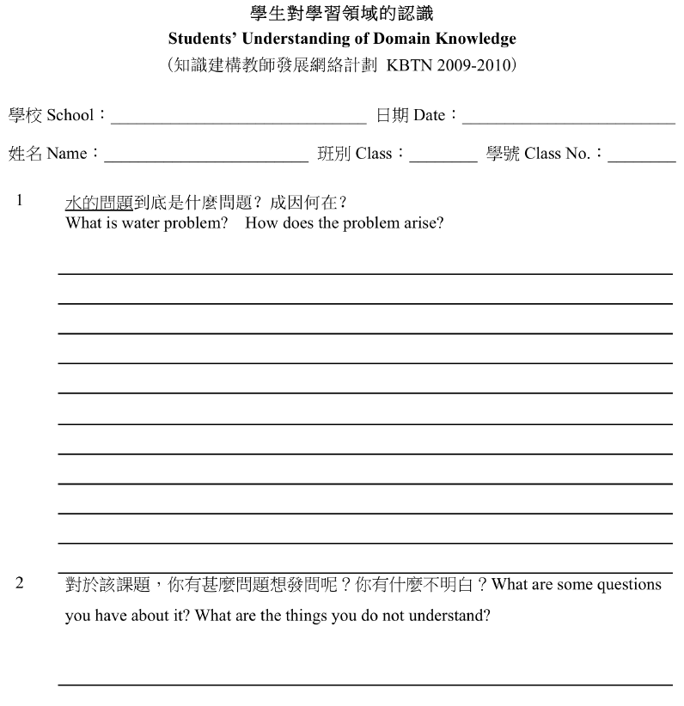

Slide 7
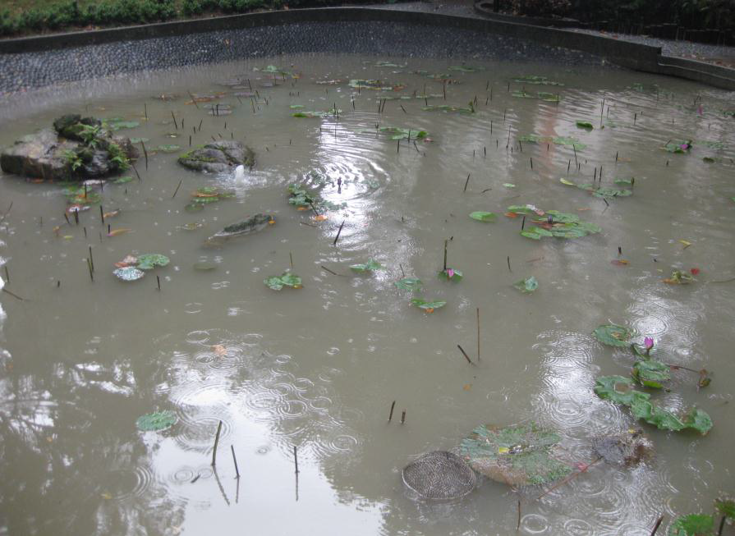
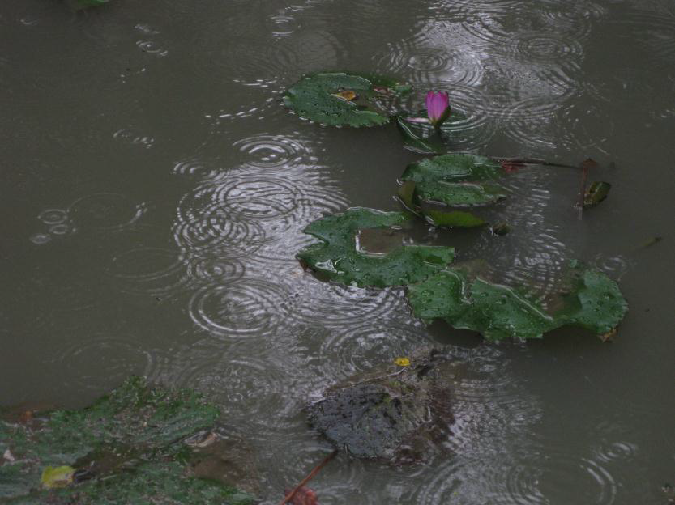
If you only had this bottle water, would you drink from it?
(Lily pond of Hong Kong University)

Slide 8
If you only had the following bottles of water, which would you choose? Why? (3 minutes)
Please write down your thoughts and ideas in your notebook after reading the following questions!
Remember to write down your explanations and evidence!

Slide 9
Sample 1 - Lily pond of Hong Kong University

Slide 10
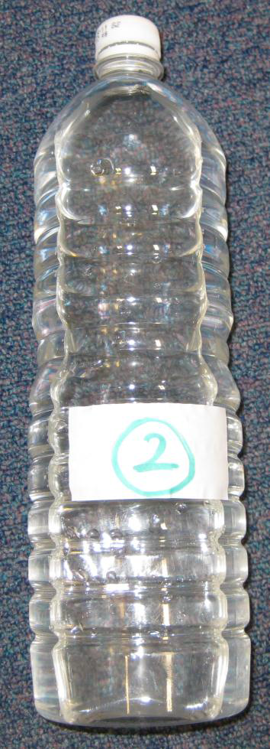
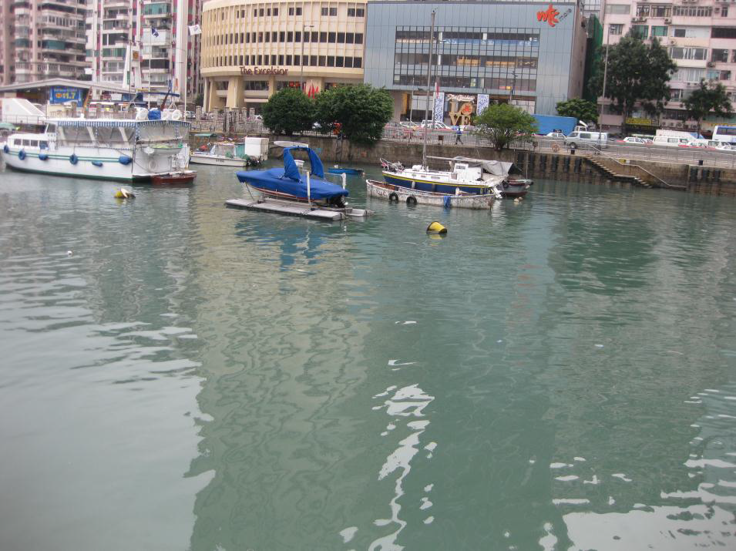
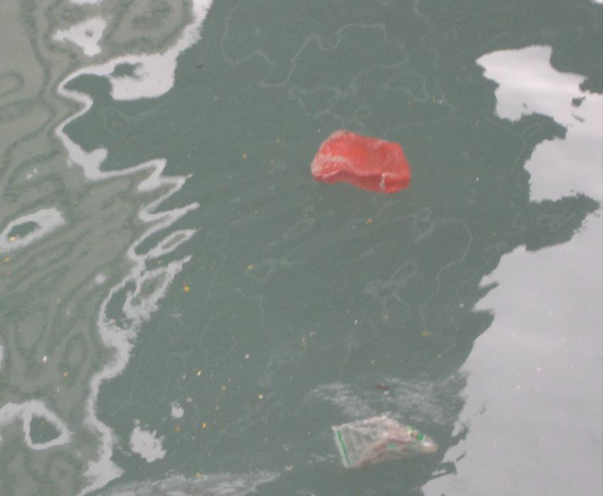
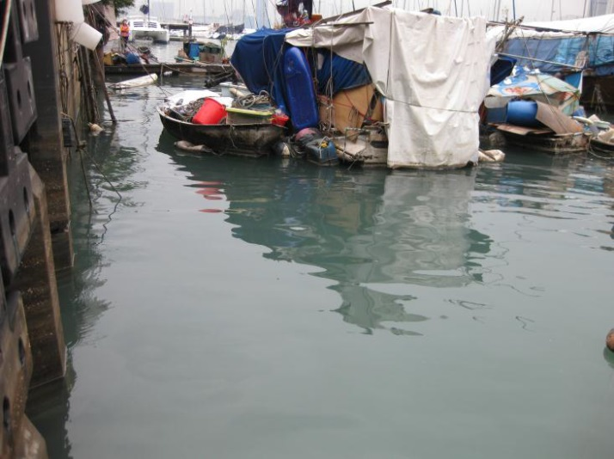
Sample 2 - Victoria Harbour (near World Trade Center)

Slide 11
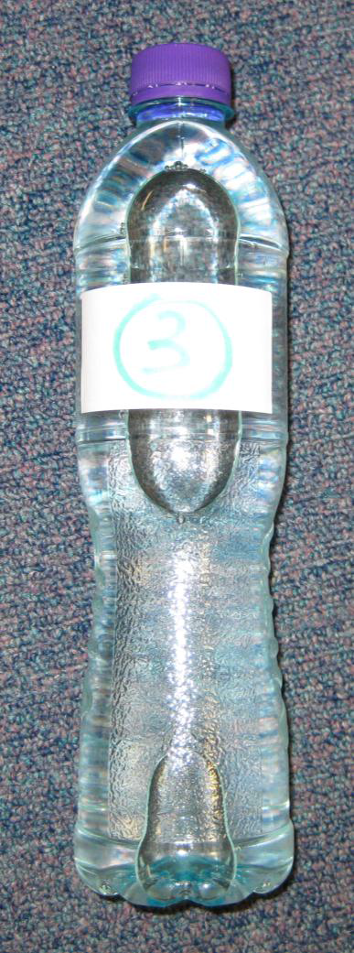
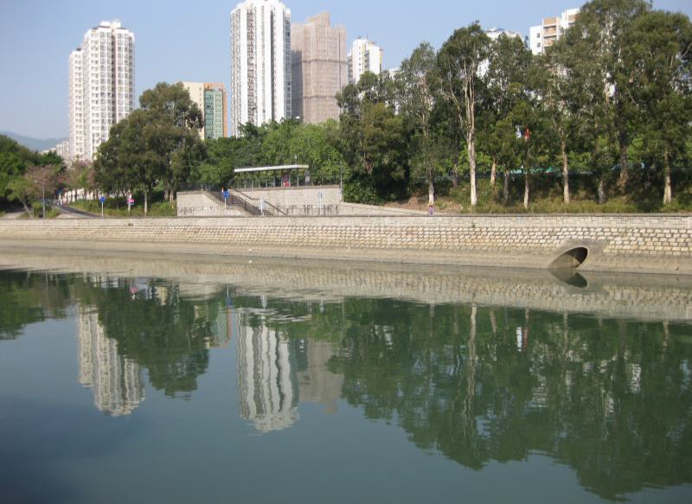
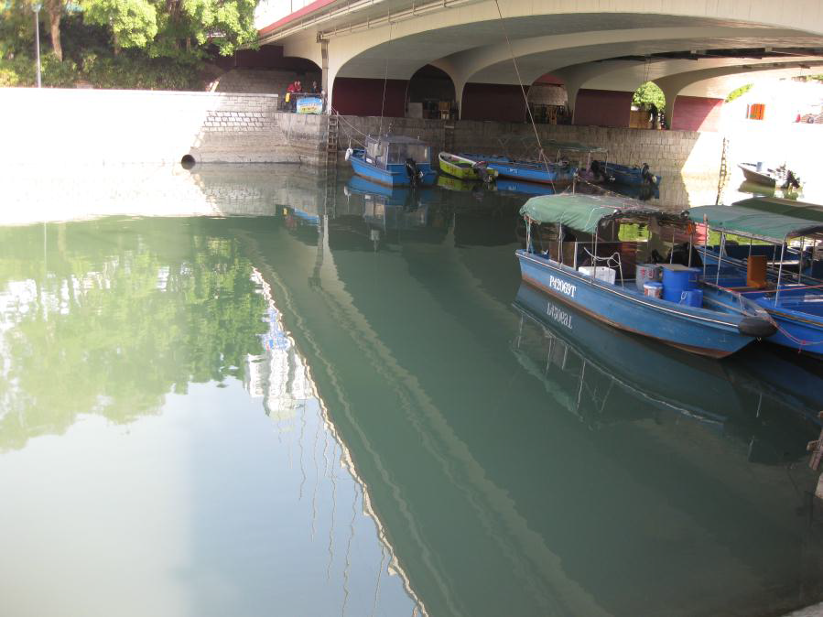
Sample 3 - Tai Po River (near Wong Siu Ching Clinic)

Slide 12
If you only had those options of water, would you drink them? Which would you choose? Why? (3 minutes)
Please write down your thoughts and ideas in your notebook after reading the following questions!
Remember to write down your explanations and evidence!

Slide 13
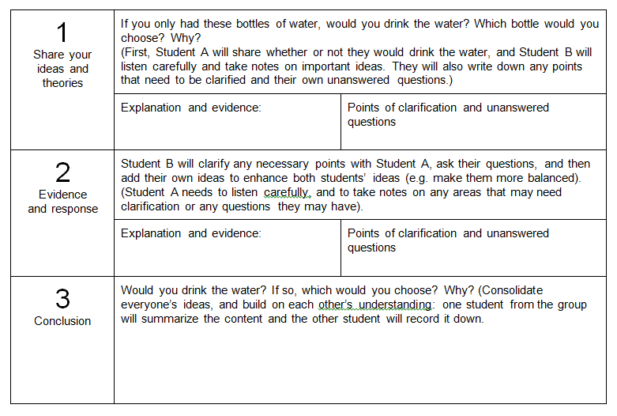
Discussion (2 people per group) 5 minutes

Slide 14
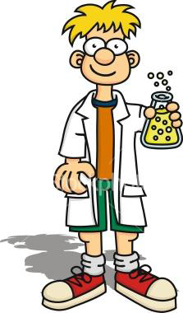
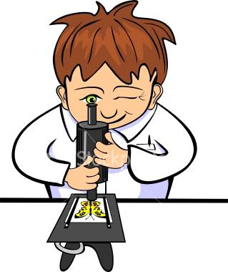
If you were a scientist, you would…
How do we confirm that the water you chose is the cleaner of the two? Why would we need to do this? What kind of data would you collect? How?

Slide 15
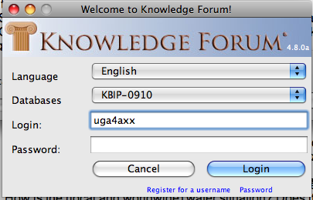
Login KF
http://kf.cite.hku.hk
Database: KBPI-0910
Username: UCA 4AXX (XX = your class no.)

Slide 18
KF Discussion
What are the problems associated with water? How do they arise?
What questions do you want to ask? What do you not understand?
If you only had these 3 bottles of water, would you drink the water? Which bottle would you choose? Why?
If you were a scientist, how would you confirm that the water you chose is the cleaner of the two? Why would we need to do this? What kind of data would you collect? How would you collect this data?

